Slide 1
Computer Systems
2nd Team Project
Memory Hierarchy Simulation
21102050 Lee In-Sun
21102052 Lee Jeong-yun

Slide 2
1
Memory Hierarchy & Cache
2
Real-World Data & Hypothesis
3
Code Explanation & Results
Contents

Slide 3
1. Memory Hierarchy & Cache
Cache: a smaller and faster storage device as a staging area for a subset of the entire data
Cache Hit: requested data by upper Cache exists in the Cache
Cache Miss: the requested data does not exist in the Cache
Hit rate: fraction of memory reads which are satisfied from the Cache.
Miss rate: fraction of memory reference not found in Cache

Slide 4
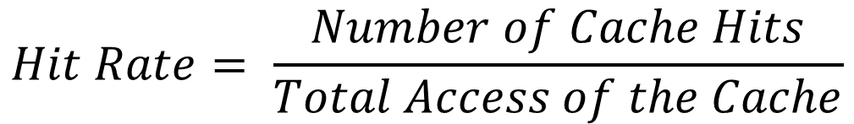
1. Memory Hierarchy & Cache
How to Calculate hit rate?
$$Hit Rate= \frac{Number of Cache Hits}{Total Access of the Cache}$$
How to Calculate hit rate?
$$Miss Rate=1− \frac{Number of Cache Hits}{Total Access of the Cache}=1 −Hit Rate$$

Slide 5

2. Real-World Data & Hypothesis
1. Data Description
1) What data – Exchange rate (KRW / USD)
Because of the recent day’s rapid increasing exchange rate, we wanted to compare various exchange rates between the past and present.
The data represent the closing price of the exchange rate (KRW/USD) for about 30 years.
The data is collected from Investing.com which is top 3 global financial website
2) Period of Data
1981.04.14~2021.12.31 (10506 days, about 30 years)
3) Number of Data
10506 * 2 = 21,012 (Date & Closing price of exchange rate)

Slide 6
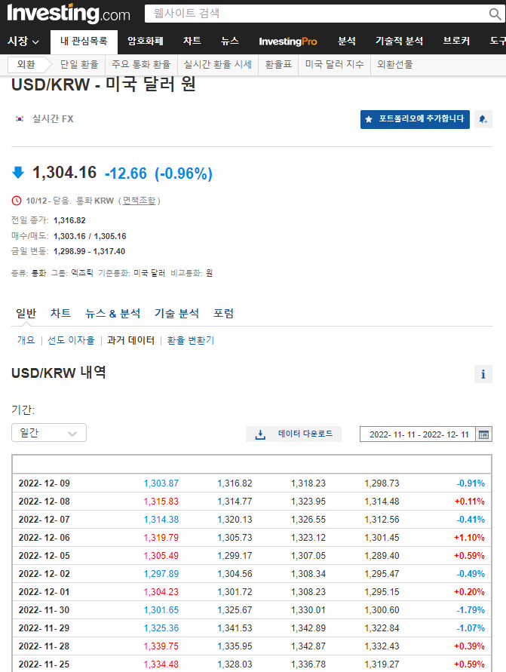
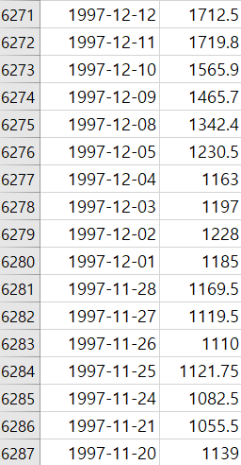
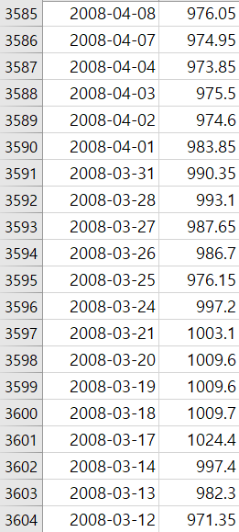
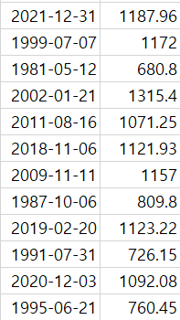
2. Real-World Data & Hypothesis
1. Data Description
IMF economic crisis
in 1997 - 2001
Subprime mortgage crisis
in 2008
Randomly
Selected Data
Investing.com
We will use 2 columns → 2-dimensional array

Slide 7
2. Real-World Data & Hypothesis
2. Hypothesis
After selecting a specific dataset from the user, a program that returns the date’s exchange rate will be implemented.
Assume that searching for a continuous period when the IMF economic crisis in 1997 be occurred by users, the hit rate at the upper-level Cache might be greater than the hit ratio at the lower level one.
Assume that the user will search a specific day or period several times again when the global financial crisis occurred, the hit rate at the upper-level Cache might be greater than the lower-level one.
Assume that the user will search for a random date, the hit rate of the lower-level Cache might be greater than the hit rate of the upper-level one.

Slide 8


2. Real-World Data & Hypothesis
3. How to implement our memory hierarchy
Make a memory hierarchy consisting of 4 layers considering the used real-world data by using the concept of the 2-dimensional array to return the price of the data.
Check the miss rate that is shown based on the used real-world data.
4. Development tool

Slide 9
2. Real-World Data & Hypothesis
L0
~ 1KB, 0.3 ns
Smaller,
faster,
and
costlier
(per byte)
storage
devices
Registers
L1
L1 Cache
(SRAM)
1~256KB, 1.1~10 ns
L2
L2 Cache
(SRAM)
256KB~1MB, 10~20 ns
16 elements
L3
L3 Cache
(SRAM)
1~8MB, 20~40ns
256 elements
Larger,
slower,
and
cheaper
(per byte)
storage
devices
L4
Main Memory
(DRAM)
8MB~32GB, 40~80ns
4096 elements
L5
Local secondary storage
(local Disks)
~200GB~1TB, ~0.1ms
9468 * 2 elements
L6
2~5TB, ~3ms
Remote secondary storage
(distributed file systems

Slide 10
2. Real-World Data & Hypothesis
L1
L1 (1)
L2
L2 (16)
L3
Hit
Copy to upper Cache
L3 (128 * 2)
L4
L4 (4096)
Miss
Access next Cache
Disk
Disk (10506, total data)
Memory Hierarchy Model

Slide 11
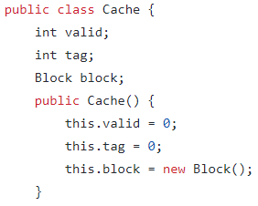
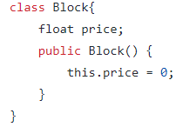
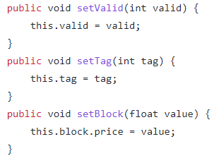
3. Code Explanation & Results
Cache class that consists of valid, tag, and block.
Block consists of price that represent the real exchange rate.
We make 3 different setter methods that initialize valid, tag, and Block.price.

Slide 12
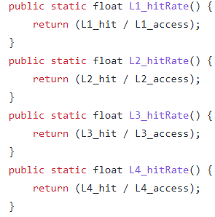
3. Code Explanation & Results
4 methods that return each level’s hit rate
L#_hit represents the number of
hits in each level
L#_access represents the number of access to each level.

Slide 13
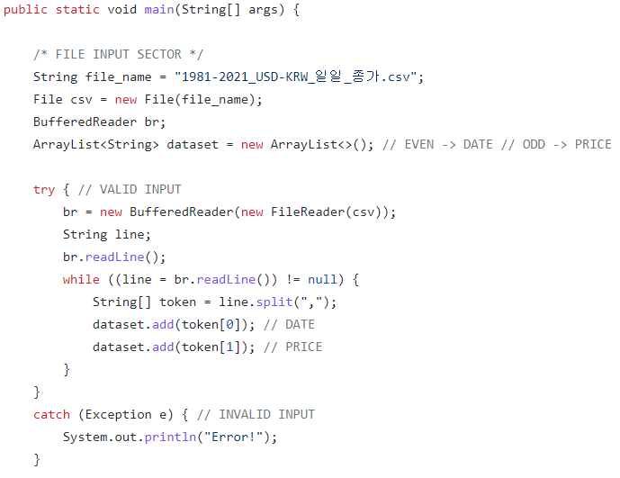
3. Code Explanation & Results
Bring the actual data from the .csv file
Put the real data into the dataset which type is ArrayList.
Use try-catch to deal with various Exception of input file.
In the try statement, split the .csv data standard of ',’ and put them in a String type ArrayList that name is token.
In index 0 in the token, there are date and in index1 in the token, there is price.

Slide 14
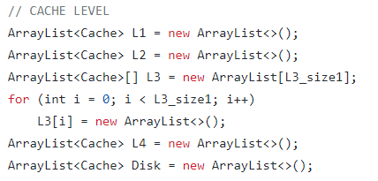
3. Code Explanation & Results
Make ArrayList each name is L1, L2, L4, Disk to represent the level of memory hierarchy.
Apply an E-way set associative Cache (E=2) to the L3 layer, we use 2 dimensional ArrayList by using for structure.

Slide 15
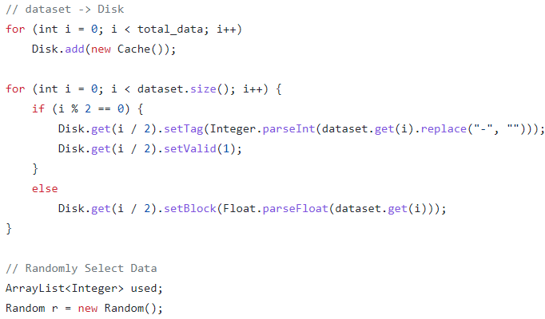
3. Code Explanation & Results
Use the for structure to add the number of total data’s Cache to the Disk.
Use for statement with an if-else structure that has a condition to judge i is even or odd
If i is even, the Disk gets the date as a tag and gets 1 as a valid.
If i is odd, the Disk gets the price as a block.
Use the Random class to set arbitrary selection situations.

Slide 16
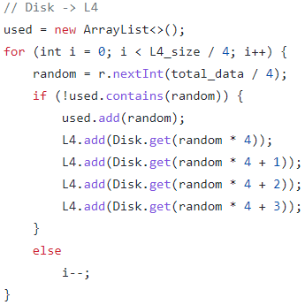
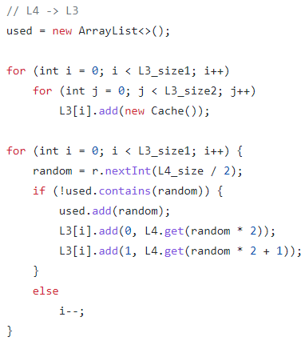
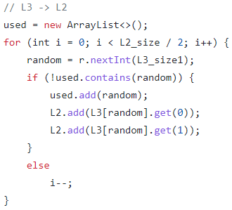

3. Code Explanation & Results
Use a for statement with an if-else to pass the data each level to level.
Put the random data to L4 from the Disk without redundancy.
Put the random data to L3 from the L4 without redundancy.
Put the random data to L2 from the L3 without redundancy.
Put the random data to L1 from the L2 without redundancy.

Slide 17
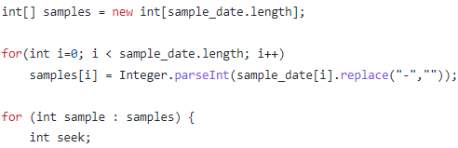
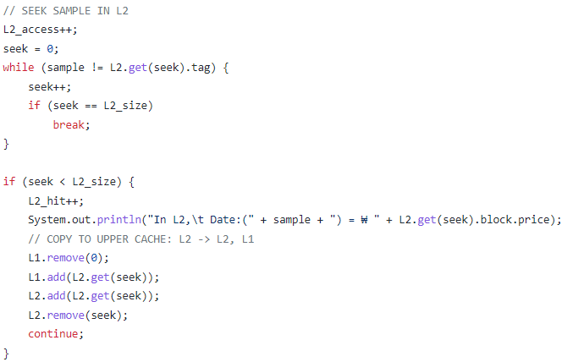
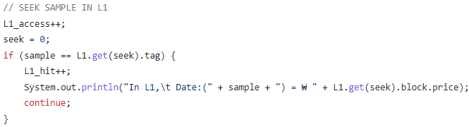
3. Code Explanation & Results
make int type array samples to put the sample data without ‘-’ and make int type variable seek index to search each level of Cache
To seek sample in L1,
compare sample with tag of index seek.
To seek sample in L2,
compare sample with tag of index seek.

Slide 18
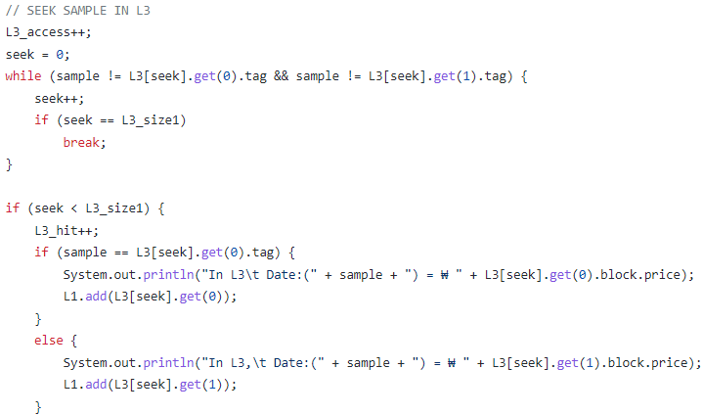
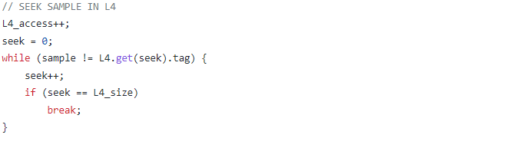
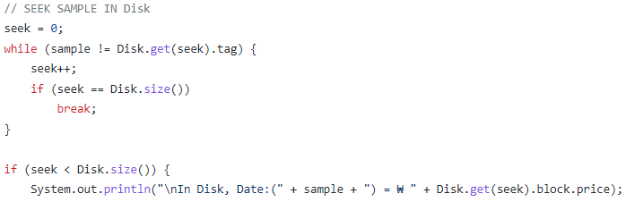
3. Code Explanation & Results
To seek sample in L3,
compare sample with [seek][0] and [seek][1] elements in L3
To seek sample in L4,
compare sample with tag of index seek.
To seek sample in Disk,
compare sample with tag of index seek.

Slide 19
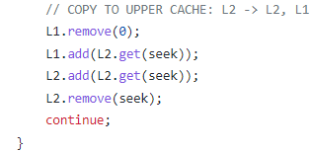
3. Code Explanation & Results
To copy Cache from L2 to L1, we remove the index 0 element
in L1 and add the seek data from L2 to L1.

Slide 20
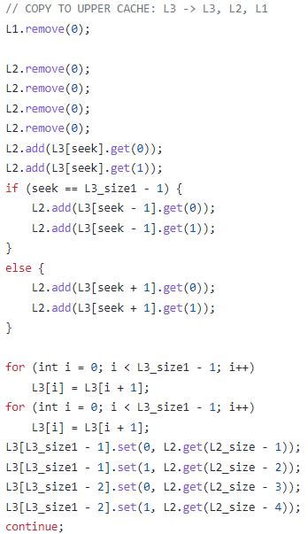
3. Code Explanation & Results
If hit occur, copy to all upper Cache.
When data is promoted to upper level,
adjacent data move together.
In this case, the hierarchy model move 4 data at once except L1.
remove 4 or 1 elements in upper Cache to secure enough space for data which will be copied.
add 4 or 1 data into all upper Cache.
Referenced data in current Cache are moved to the end of the Cache for Least Recently Used (LRU) policy.

Slide 21
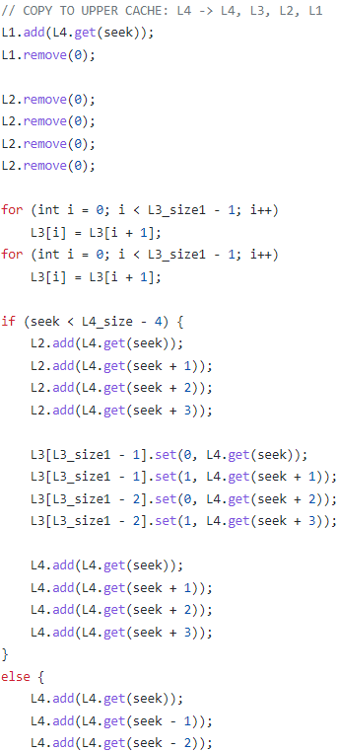
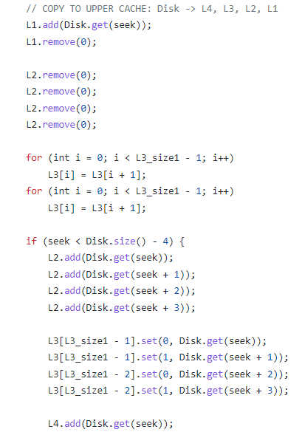
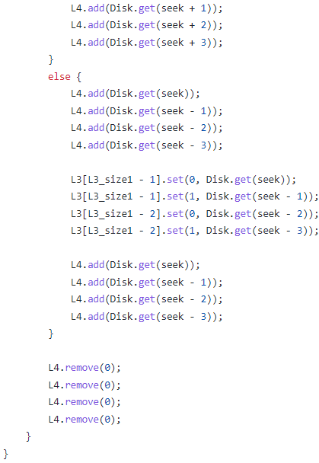
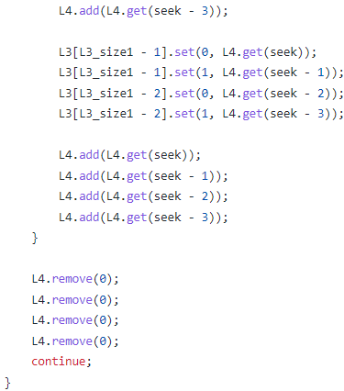
3. Code Explanation & Results
Same way is applied.

Slide 22
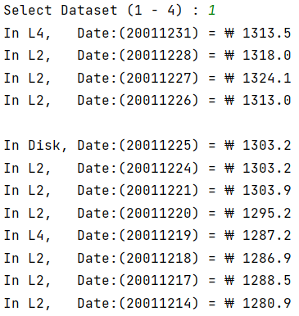
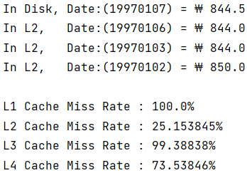
3. Code Explanation & Results
Assume that user search continuous period (1997.01.02~2001.12.31) when IMF Economic crisis occurred.
From the result, we can notice L2 Cache miss rate is about 25%, it means that the hit rate of L2 Cache is about 75%.
In this case, we can know spatial locality operates in the process of reading data for a different level of the memory hierarchy.

Slide 23
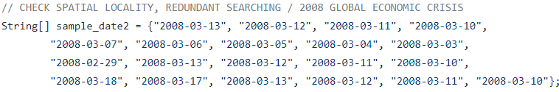
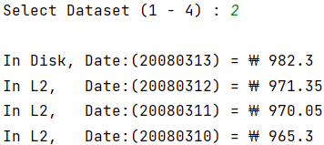
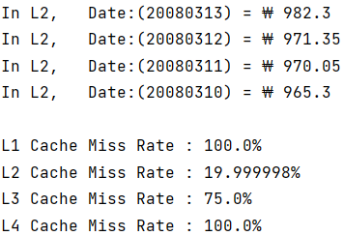
3. Code Explanation & Results
Assume that users search the same period (2008.03.13~2008.03.10) several times when Global Economic Crisis occurs.
From the result, we can notice L2 Cache miss rate is about 20%, it means that the hit rate of L2 Cache is about 80%.
In this case, we can know temporal locality operates in the process of reading data for a different level of the memory hierarchy.

Slide 24

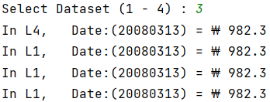
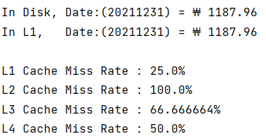
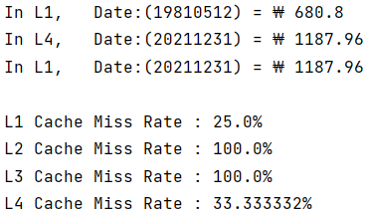
3. Code Explanation & Results
Assume that users search the same day ( 2008.03.13, 1981.05.12, 2021.12.31 ) several times.
From the result, we can notice L1 Cache miss rate is 25%,
it means that the hit rate of L1 Cache is 75%.
In this case, we can know temporal locality operates in the process of reading data for a different level of the memory hierarchy.

Slide 25
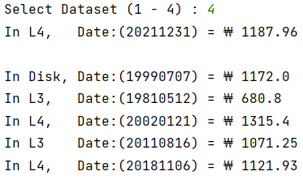
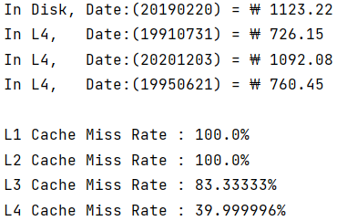
3. Code Explanation & Results
Assume that users search the random days.
L1, L2 miss rates are 100%, hit rate of L1, L2 are 0%

Slide 26
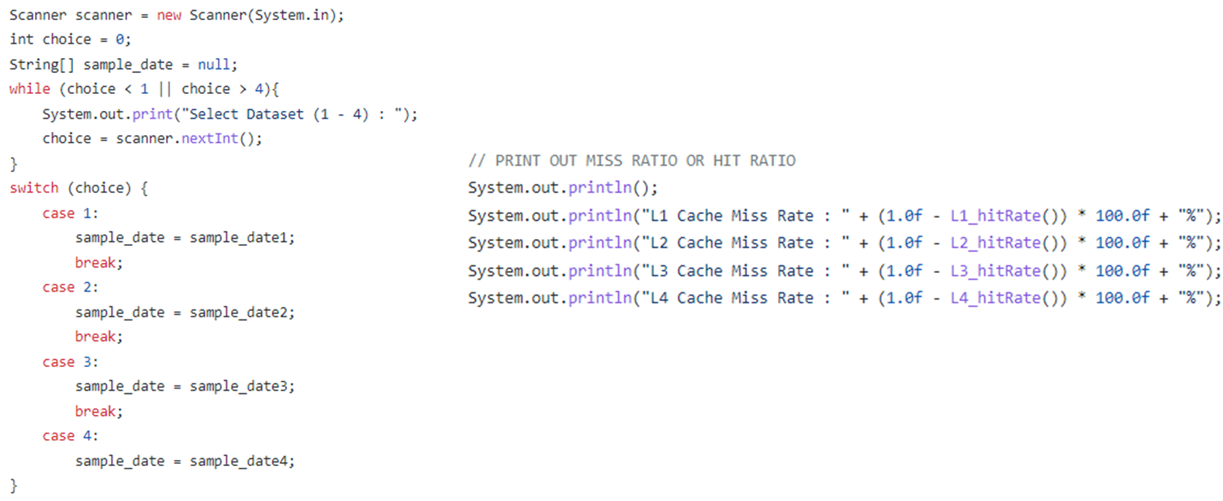
3. Code Explanation & Results
A switch statement to print the select sample data that the user chose.
Print out the miss rate in each layer of Cache, respectively.

Slide 27
Thank you

